Slide 1

Using Stochastic Collocation for Generalized Polynomial Chaos in RAVEN
RAVEN Training

Slide 2
Nomenclature
is the response from a model (e.g., PCT)
Uncertain inputs to model:
Material Properties
Boundary Conditions
Initial Conditions
Goal: What range of values can have as a result of uncertainties in ?

Slide 3
Stochastic Polynomials
Expand model as combination of polynomials
Polynomial Representation
Given a quantity of interest:
Represent as combination of polynomials:
Simpler to evaluate
Easy to get statistical moments
Less effort and more accurate than Monte Carlo
Notes:
Important points:
- Polynomials are orthonormal
- Coefficients c_k are obtained by integration
- Polynomial set \Lambda is chosen by the user (or adaptively)

Slide 4
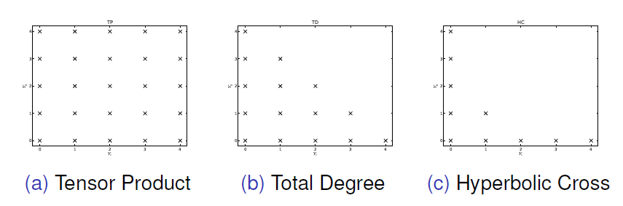
Stochastic Collocation
Effectiveness depends on:
Regularity of quantity of interest
Polynomial expansion order
Polynomial combination indices
Sparse Grid quadrature types (Gauss, Clenshaw)
Number of uncertain inputs
Tensor Product: Overkill
Total Degree: For Analytic Responses
Hyperbolic Cross: For Irregular Responses
Notes:
This slide is an opportunity to talk about when SCgPC works well, and how we choose polynomials for expansion

Slide 5
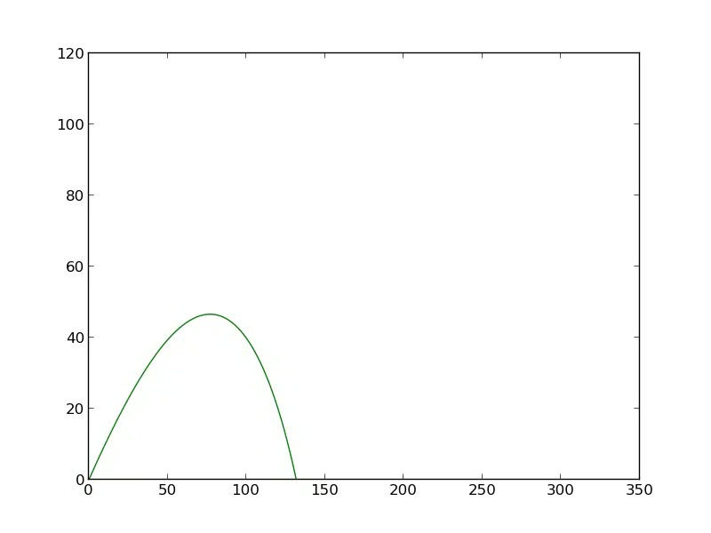
Model: Ballistic Motion
Quantity of Interest
Range of Projectile
Variables
Initial launch angle
Low: 25 degrees
High: 65 degrees
Initial Velocity
Low: 15 m/s
High: 45 m/s

Slide 6
Three Examples
Total Degree index set
First, Second, Third order polynomials
Sample points for ROMs
Train ROMs
Write ROMs to file
See “scgpc_trainer_1.xml” (and 2, and 3)

Slide 7
Validate and Compare
Check validity of ROMs against original model
Sample original model (MC, Grid, LHS)
Load ROMs from file
Sample ROMs with same samplers
Plot results
See “mc.xml”, “grid.xml”, “lhs.xml”

Slide 8
Results: Monte Carlo (200 samples)
Notes:
Note that the first-order polynomials fail to capture any effect from the angle, and undershoot the maximum range quite a bit.

Slide 9
Results: Monte Carlo (200 samples)
Notes:
Basically identical to MC results

Slide 10
Results: Monte Carlo (200 samples)
Notes:
Basically identical to MC results

Slide 11
Conclusions
Polynomial ROMs
Cheap to create
Fast to evaluate
Accurate
Exceptions
High dimension input space
Irregular response

